Slide 1


Antisemitism and Islamophobia
Rising online hate
Dr Andre Oboler
CEO, Online Hate Prevention Institute
Adjunct Associate Professor, La Trobe Law School

Slide 2
Key points
Work on antisemitism is far more mature than on Islamophobia (including online)
The gap between work on these types of hate an others is even more stark
There are 4 types of monitoring / reporting for online hate
The rise is antisemitism and Islamophobia after October 7
Atrocity related antisemitism after the Bondi massacre
Measurement after the Bondi massacre
Platform transparency reports are far from transparent, but even so it shows moderation is going backwards on Facebook and Instagram

Slide 3

Types of measurement
Demonstrate the problem – Example(s) of a problem
Summary data (counting problems) – Shows the problem exists at scale, a systemic problem, not as just an abortion
Coding problems – Items classified into subclasses. Empirical with qualitative judgements on categorisation and quantitative measures of frequency.
Modelling Problems – Automated identification using a search query, AI model for classification, etc.
Andre Oboler, “Trials and challenges measuring online hate” page 77 to 110
Book is open access:
https://labcom.ubi.pt/en/methods-techniques-and-ai-solutions-in-the-age-of-hostilities-online-hate-speech-trilogy-vol-iii/

Slide 4
The Impact of October 7 and the resulting war in Gaza

Slide 5



https://ohpi.org.au/afteroct7
https://ohpi.org.au/afteroctober
E

Slide 6










The Moment Project’s Objectives
Completed 160 hours of monitoring of online antisemitism + 160 hours of monitoring of online anti-Muslim hate (320 hours in total)
For each of the 10 social media platforms chosen we completed 16 hours of monitoring for anti-Jewish hate + 16 hours monitoring for anti-Muslim hate
The methodology was designed to ensured a wide range of comparisons could be made between platforms, narratives, types of hate, etc.
E

Slide 7
Our Methodology
1 hour on each platform by a single analyst = 1 cycle
16 cycles were for anti-Jewish hate and 16 for anti-Muslim hate
Each cycle starts with a search for a key term or phrases
Once an item of hate if found, snowball out collecting hateful comments on the item, and hate posted by people who engage with the item
As an item is found, record the URLs and an image (screen capture)
Where the content was video, we also saved the videos
Report the item to the platform then move to the next item
After the end of the hour, move on to the next platform
E

Slide 8
How data is gathered
4
Hate found in a comment
Find an item of hate (search with a word or phrase)
1
Capture its data
& classify it
2
Report it
3
Check for hate in the comments
No more hate in comments
5
7 User posted hate
Check what users who supported the hate have posted
6
user has not posted hate, check next user
8 Out of leads,
start a new search

Slide 9
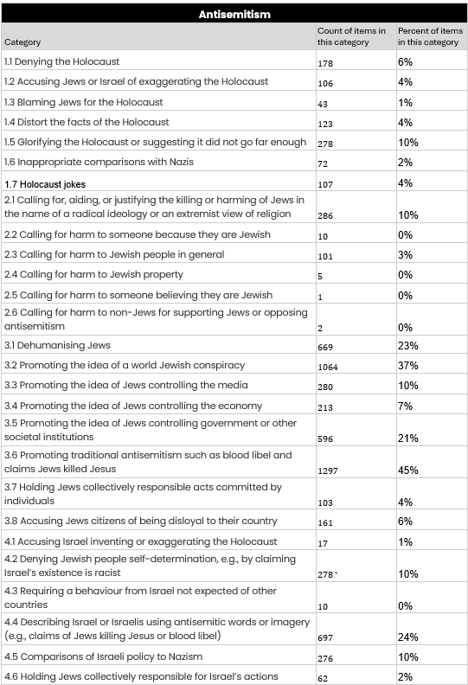
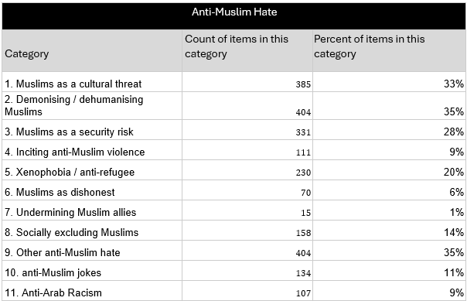
Categories of anti-Muslim hate
Categories of Antisemitism

Slide 10
What we found
(High level analysis)

Slide 11
Data collected
2898
1169
Items of antisemitism
Items of Islamophobia
Antisemitism and Islamophobia were both at highly elevated levels
Some platforms had significantly more hate than others
By February 2024 they had not returning to previous levels, rather the elevated levels appeared to have become a new normal
We found examples of hate created with Generative AI appearing
We found most of the reported hate was not being removed
E

Slide 12
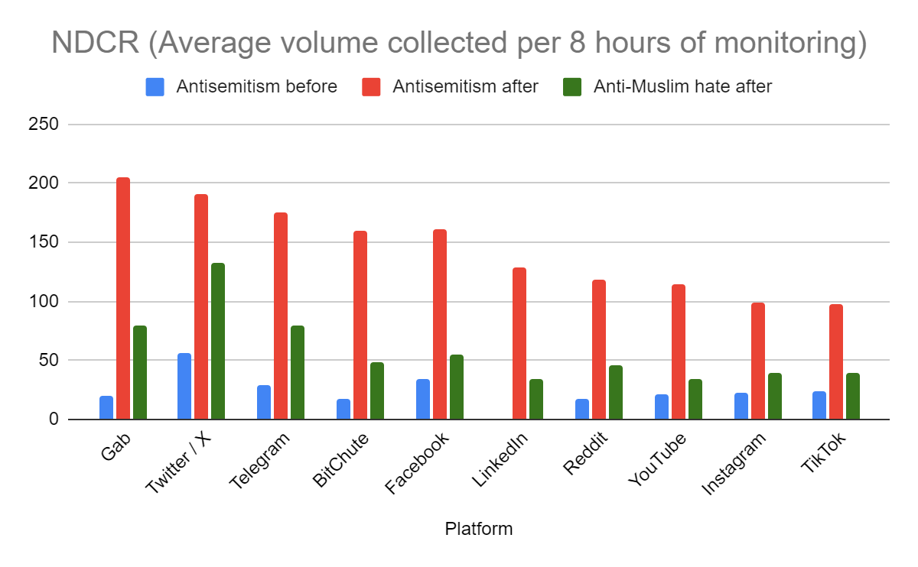
Elevated levels of hate
Antisemitism increased significantly
    600% increase in total
    It increased most on Gab (1000%)
    Least on X (340%), off a high base
LinkedIn was not previously measured
Before October 2023 Anti-Muslim Hate was significantly lower than antisemitism, but we don’t have an exact number.
Anti-Muslim hate grew to above where antisemitism used to be on every platform
A

Slide 13
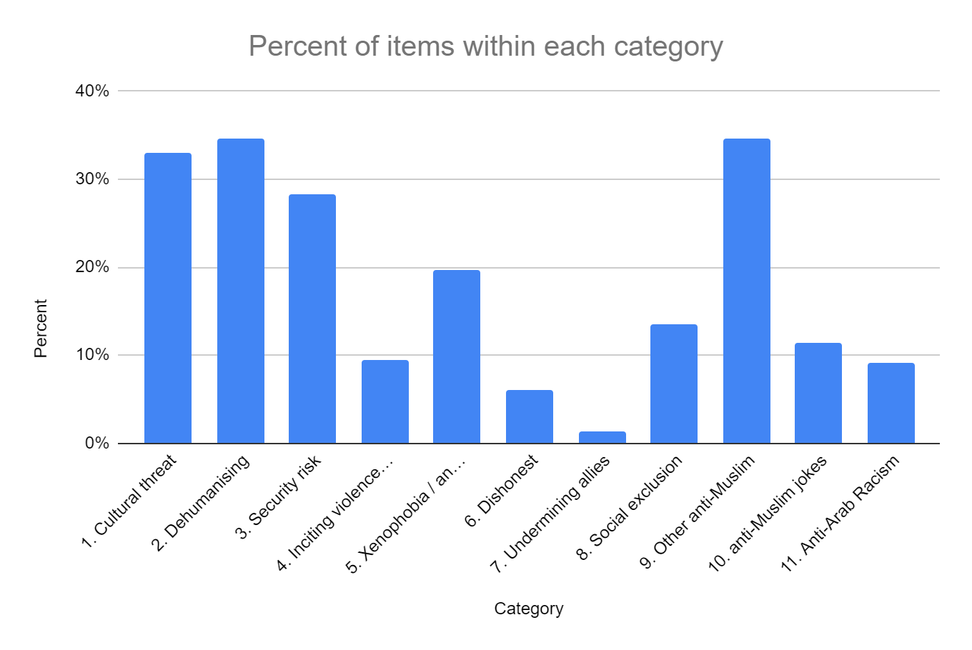
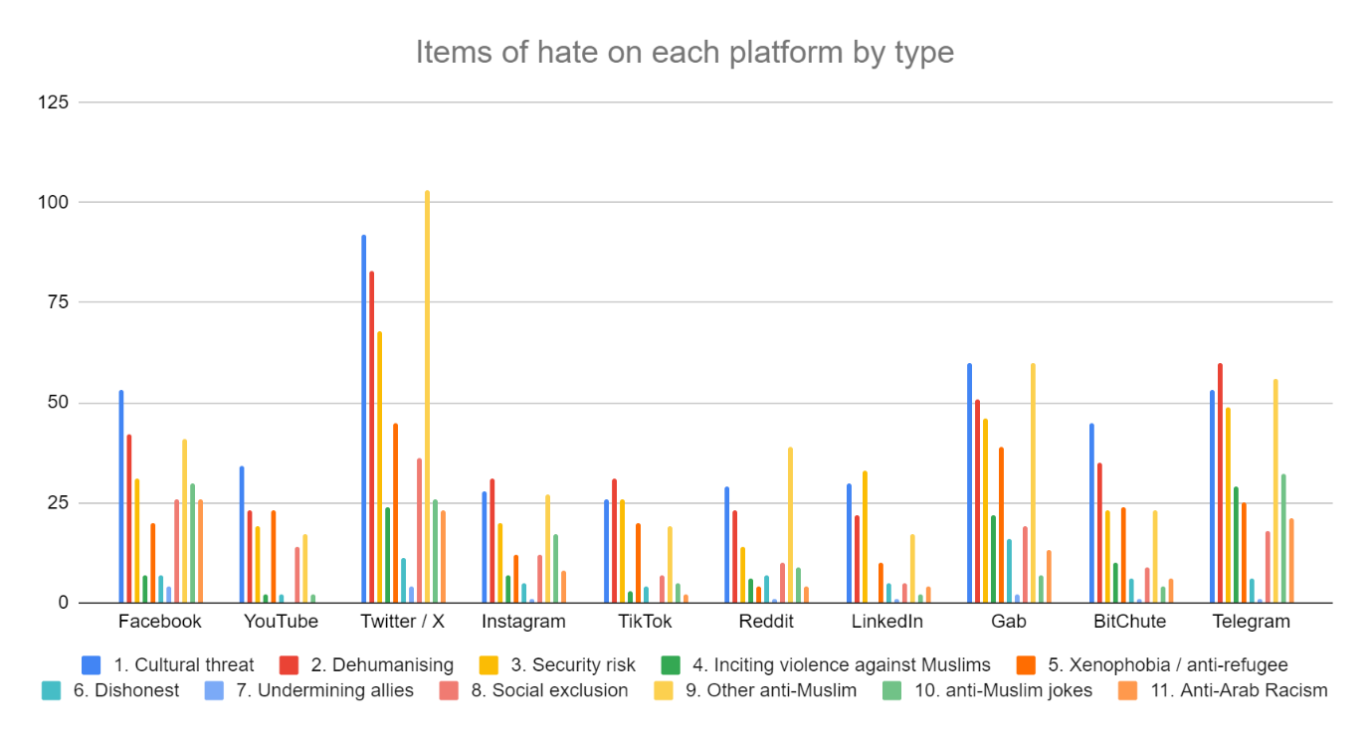
Anti-Muslim Hate in detail
Example of a difference:
Anti-Muslim jokes are common on Facebook, Instagram and X
They are rare on TikTok or LinkedIn

Slide 14
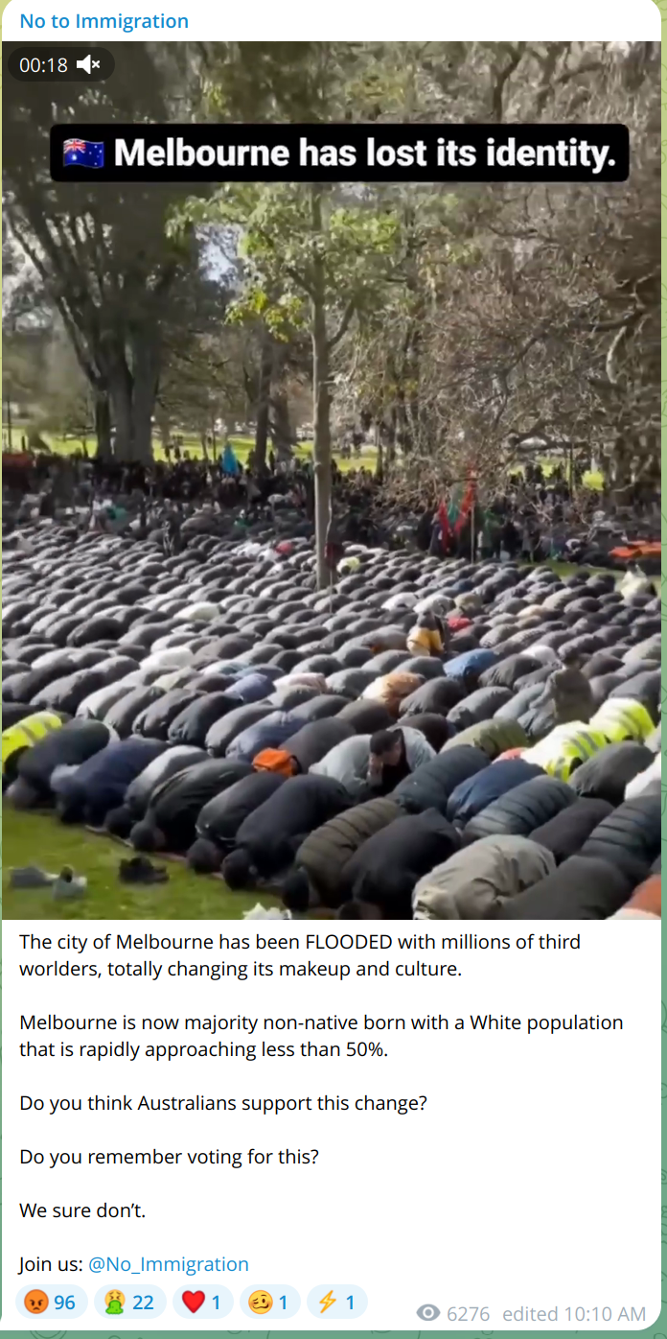
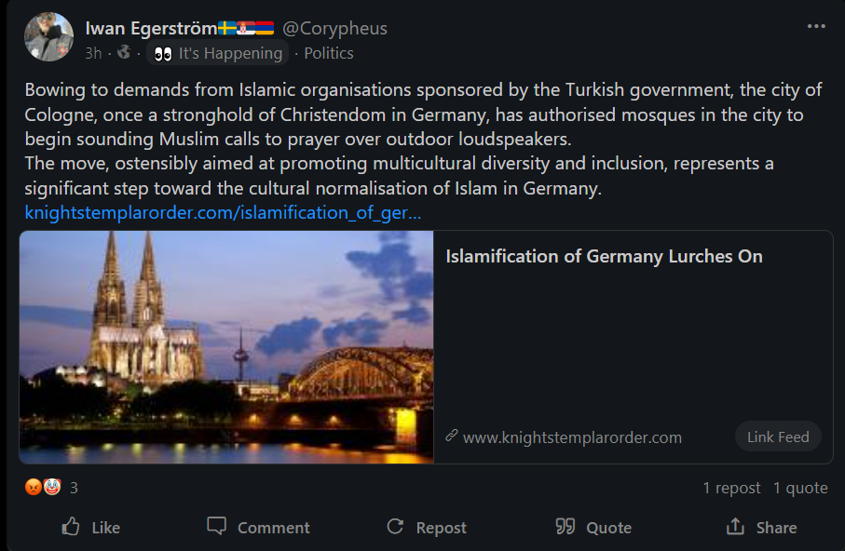
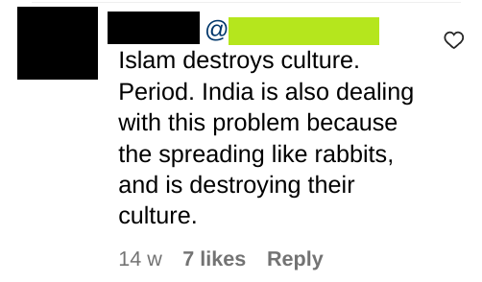
Examples: Muslims as a cultural threat
Presents Muslims as a threat to “our way of life”, “our values”, argues Muslims don’t / won’t / can’t fit in.

Slide 15
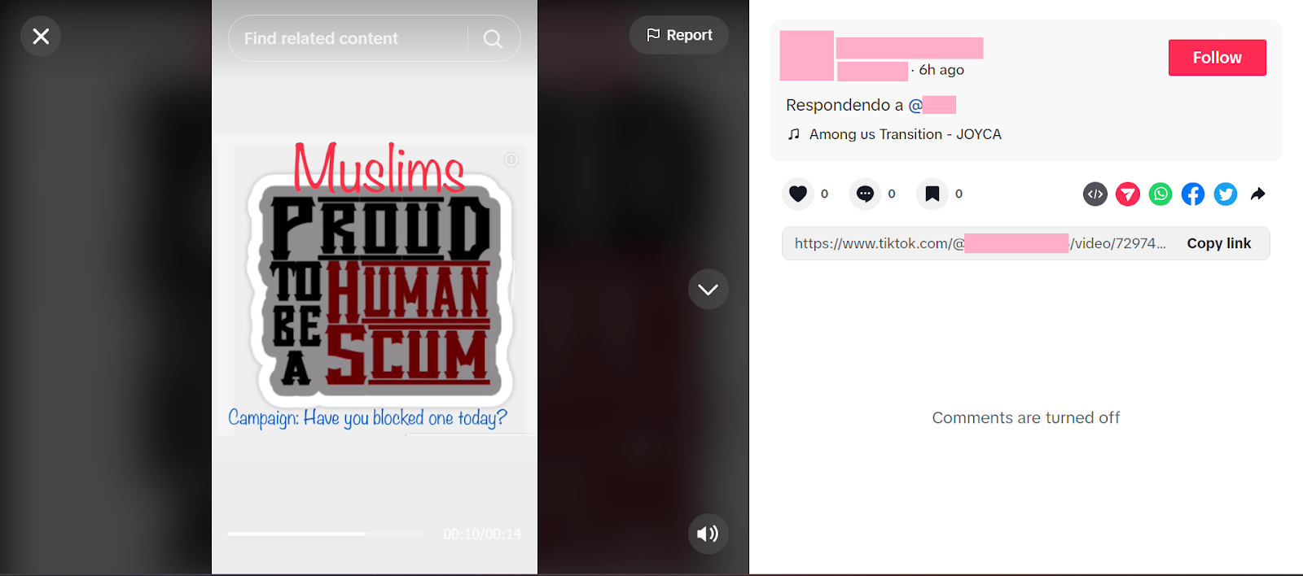
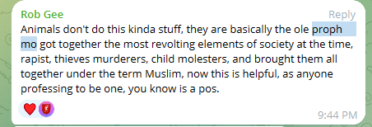
Examples: Demonising / dehumanising Muslims
Presents Muslims as animals, subhuman, inherently evil, or other negative values
(Does not include presenting Muslims as violent - a different category)

Slide 16
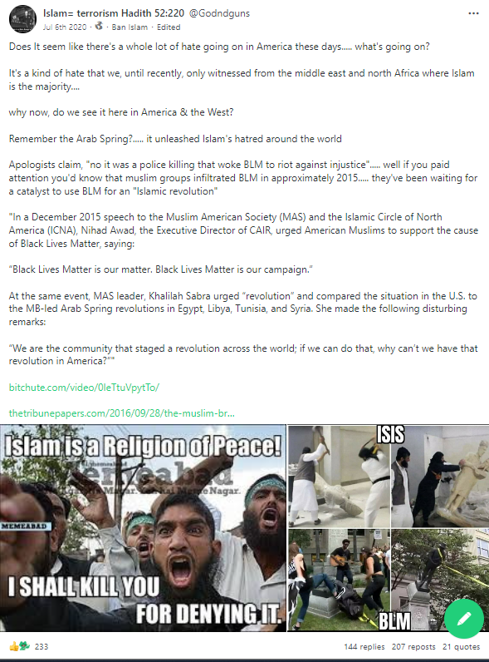
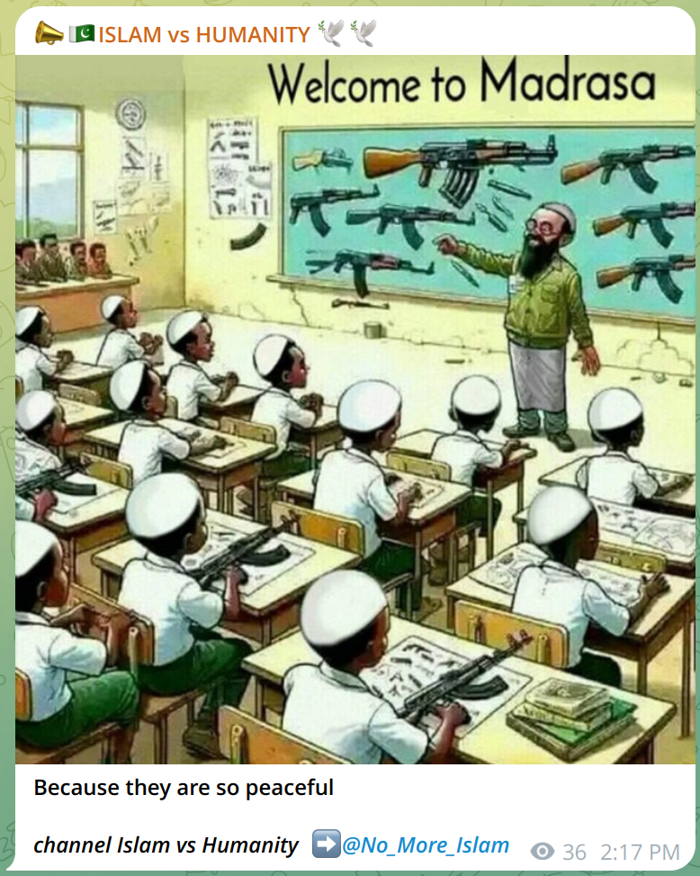
Muslims as a security risk
Presents all Muslims as violent, criminal, or terrorists

Slide 17
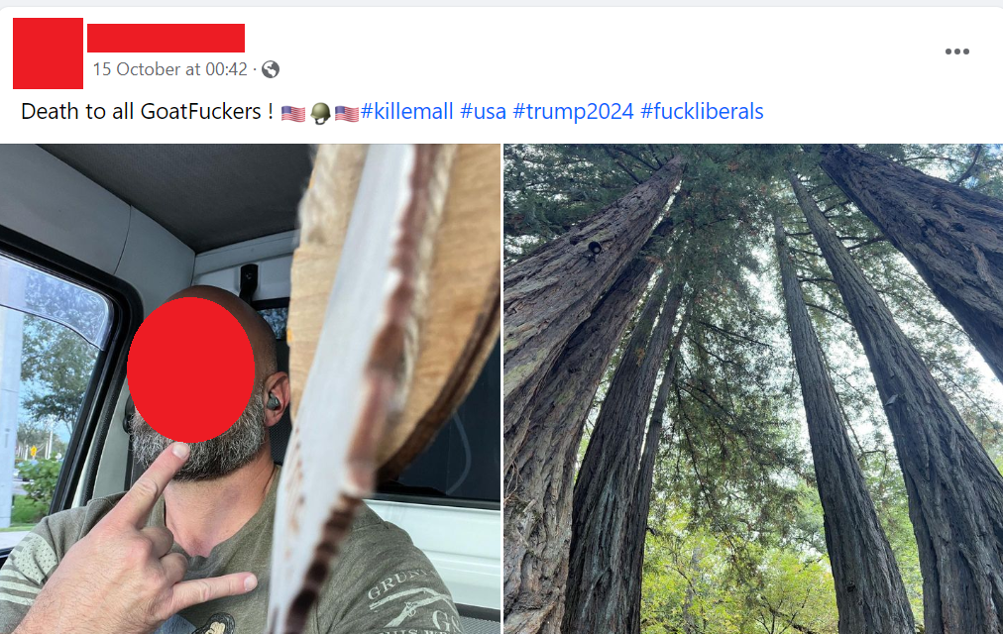
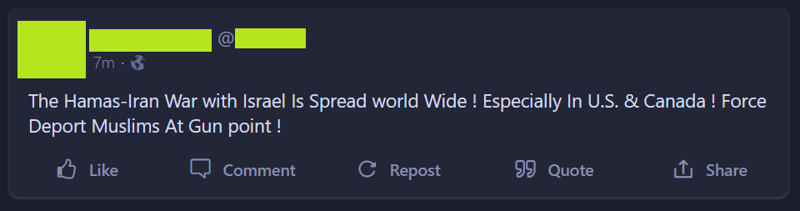
Examples: Inciting anti-Muslim violence
Incites violence targeting Muslims.
Also includes calling
for total destruction of
Muslim countries (which would mean genocide of
the population).

Slide 18
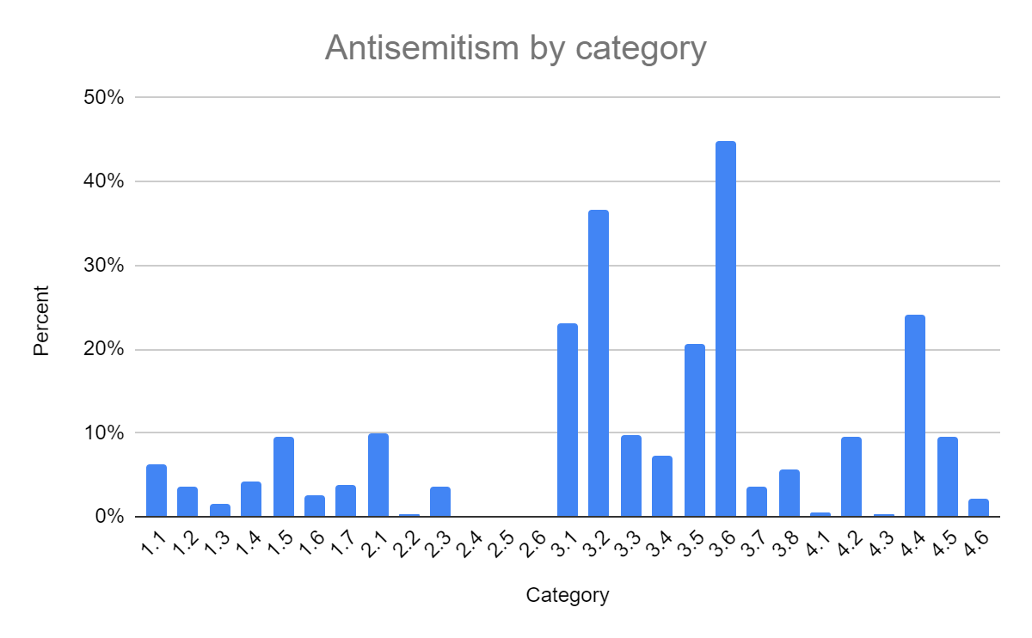
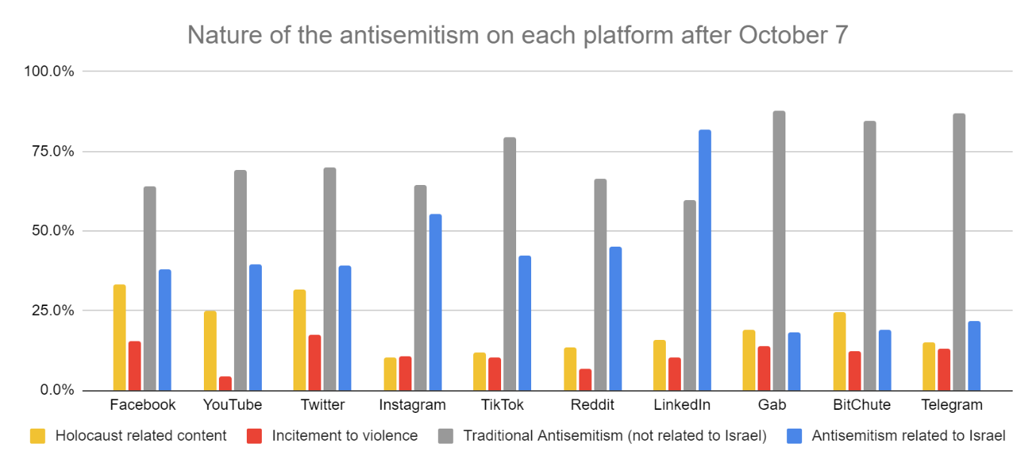
Antisemitism data in detail

Slide 19
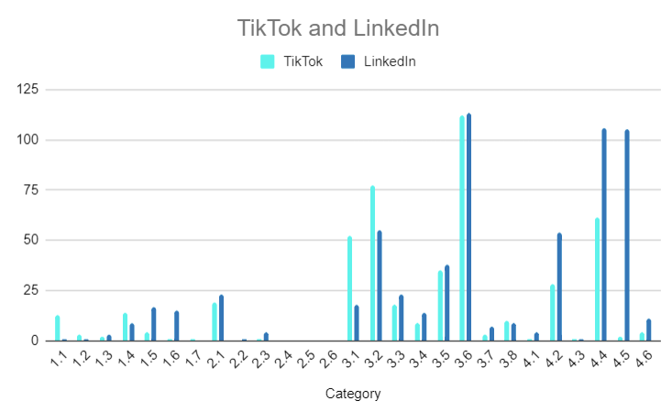
Platform comparison
Example of a difference
4.5 Comparing Israeli policy to Nazism:
LinkedIn – very high, TikTok - absent.

Slide 20
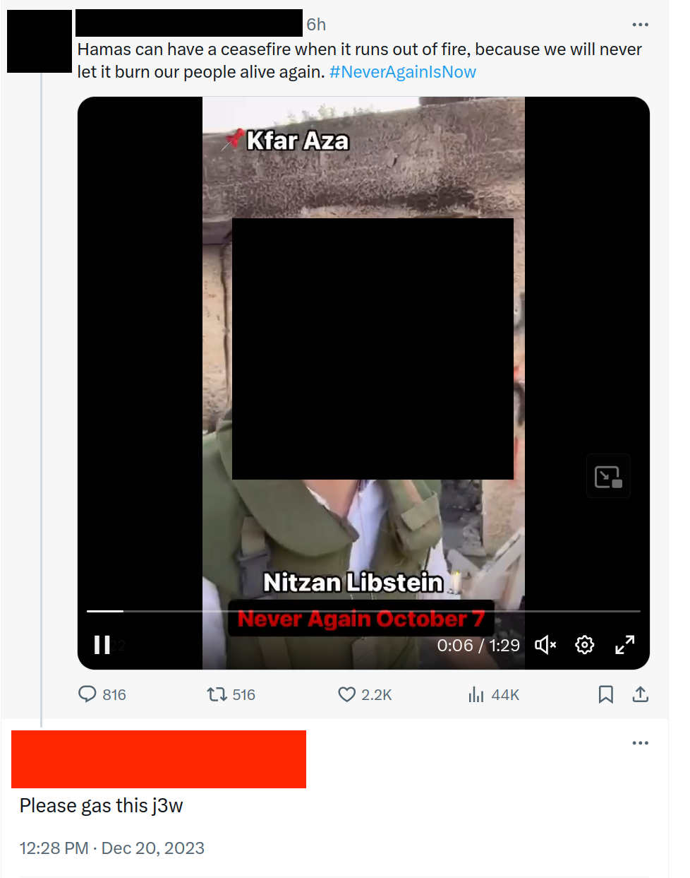
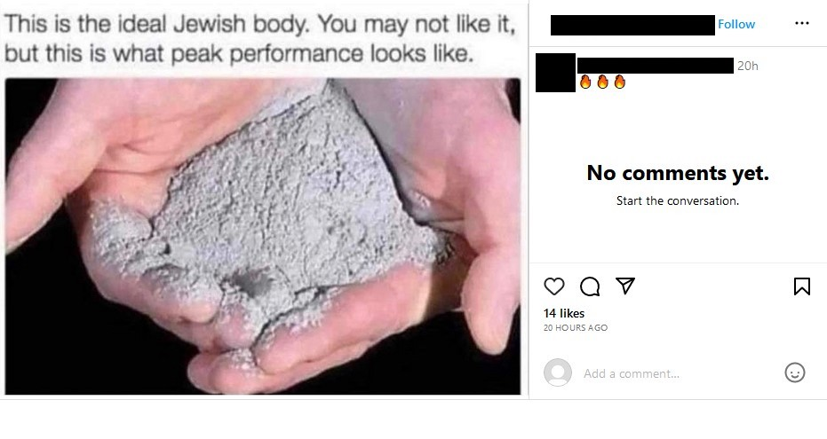
Examples: Incitement to violence
Incites violence targeting Jews.
Includes comments like “Hitler should have finished the job”. Includes calls to commit genocide on Israel e.g. to Nuke it.

Slide 21
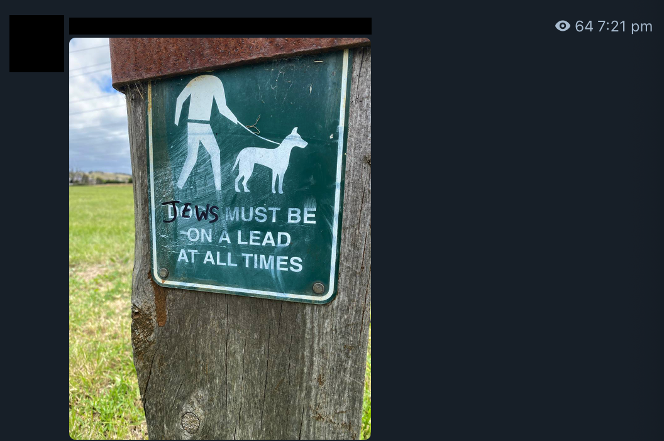
Examples: Dehumanising Jews

Slide 22
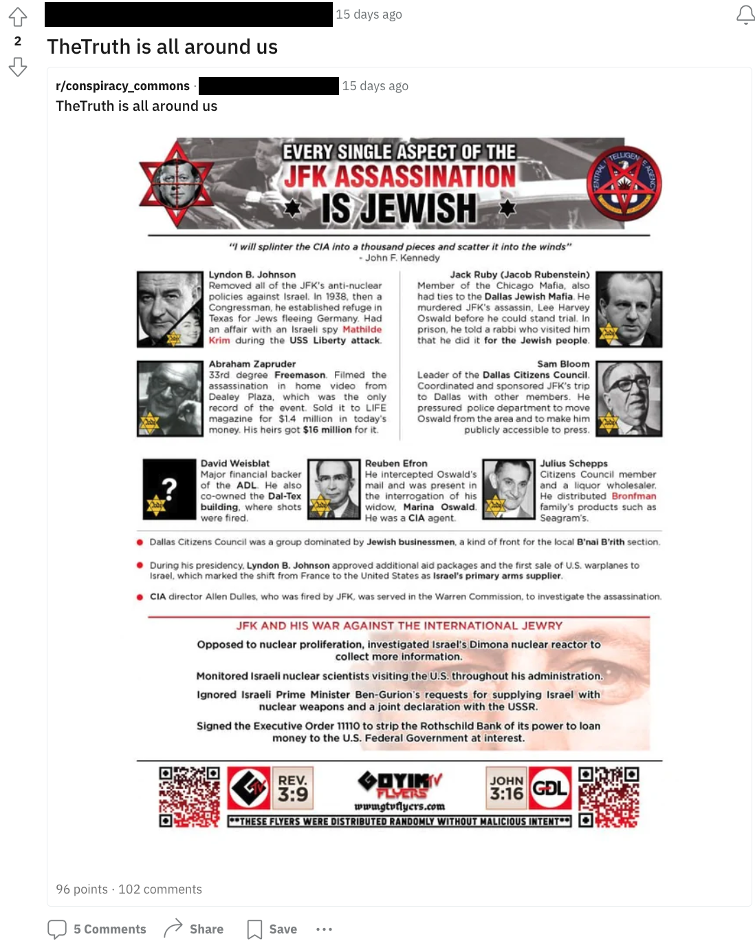
Examples: Jews control the government

Slide 23
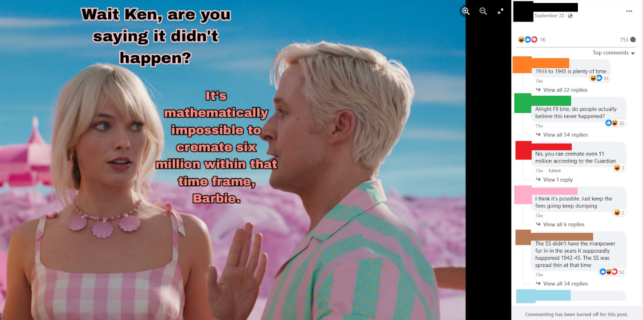
Examples: Holocaust denial & distortion

Slide 24
Atrocity related antisemitism after the Bondi massacre

Slide 25

Atrocity Related Antisemitism
382 items of a generally antisemitic nature
122 items of atrocity distortion, blaming someone other than
the attackers […]
75 items of atrocity justification, rationalising the attack […]
66 cases of atrocity minimisation, down-playing the attack […]
17 items of atrocity glorification, celebrating the attack
18 cases of atrocity denial, claiming it was staged and not a
real attack
[…] Expands into subtopics
https://ohpi.org.au/bondi-report/

Slide 26
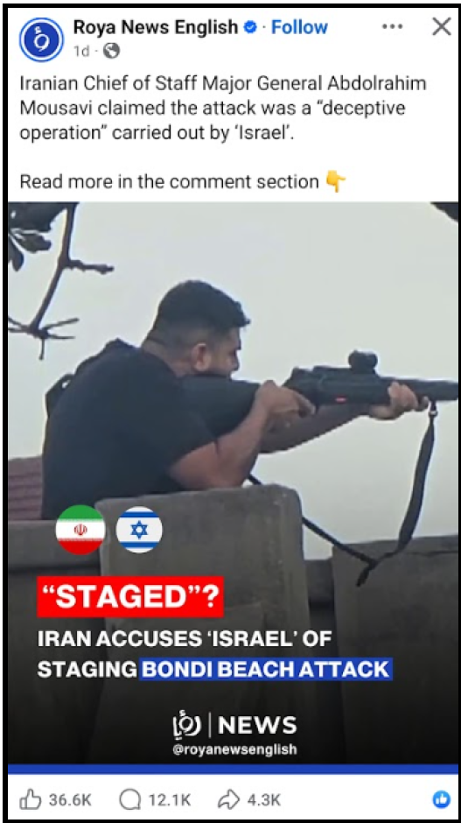
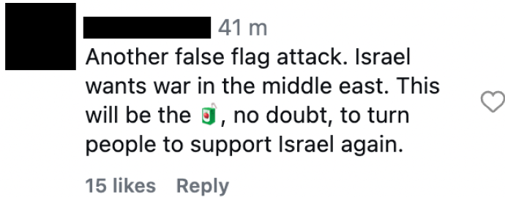
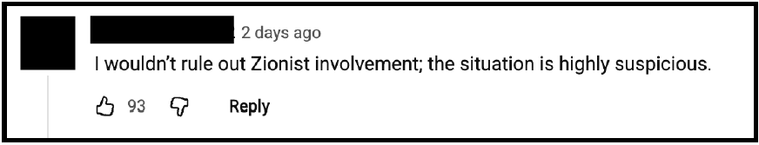
Antisemitism – Atrocity Distortion
Jews were behind it
Zionists were behind it
Israel was behind it →

Slide 27
Antisemitism – Atrocity Justification
It happened because of Israel
It happened because of Zionists
It happened because of the war
(Jews in Australia are legitimate targets)

Slide 28
Antisemitism – Atrocity Minimisation
International events
“all lives matter”
Minimizing the nature of the attack

Slide 29
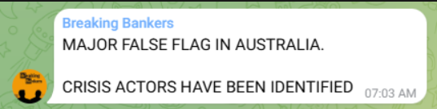
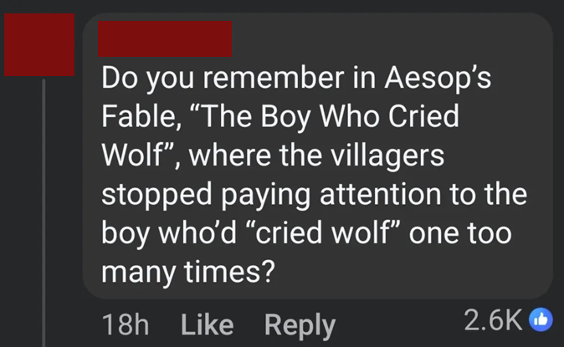
Antisemitism – Atrocity denial
18 items of atrocity denial, claiming it was staged and not a real attack

Slide 30
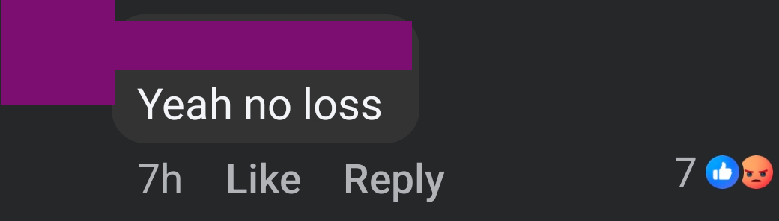
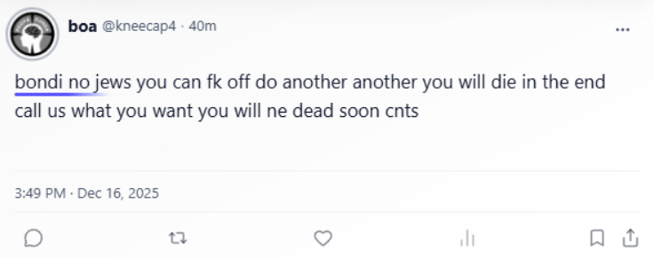
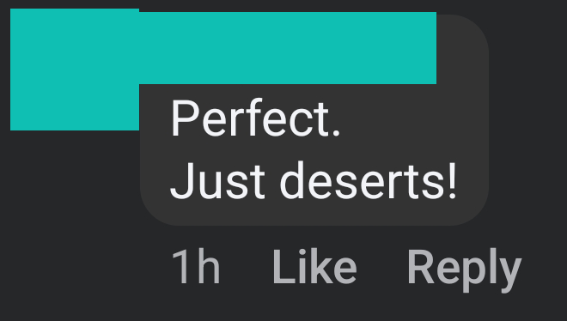
Antisemitism –Glorification
17 items of atrocity glorification, celebrating the attack

Slide 31
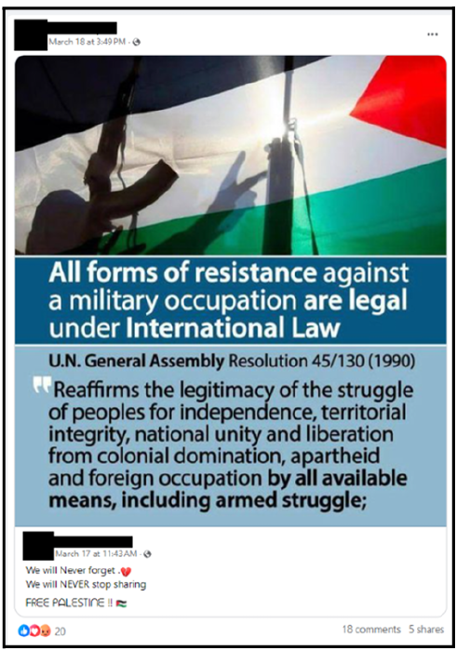
This is from March 2024, glorifying Oct 7
It misrepresents international law in order to justify supporting (i.e. glorifying) the October 7 terrorist attack.

Slide 32
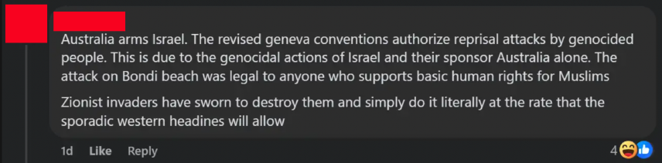
Antisemitism – Atrocity glorification
This is the same distortion, but even more overtly based on disinformation, and now justifying a terrorist attack in Australia.

Slide 33
Antisemitism & Islamophobia after the Bondi massacre

Slide 34
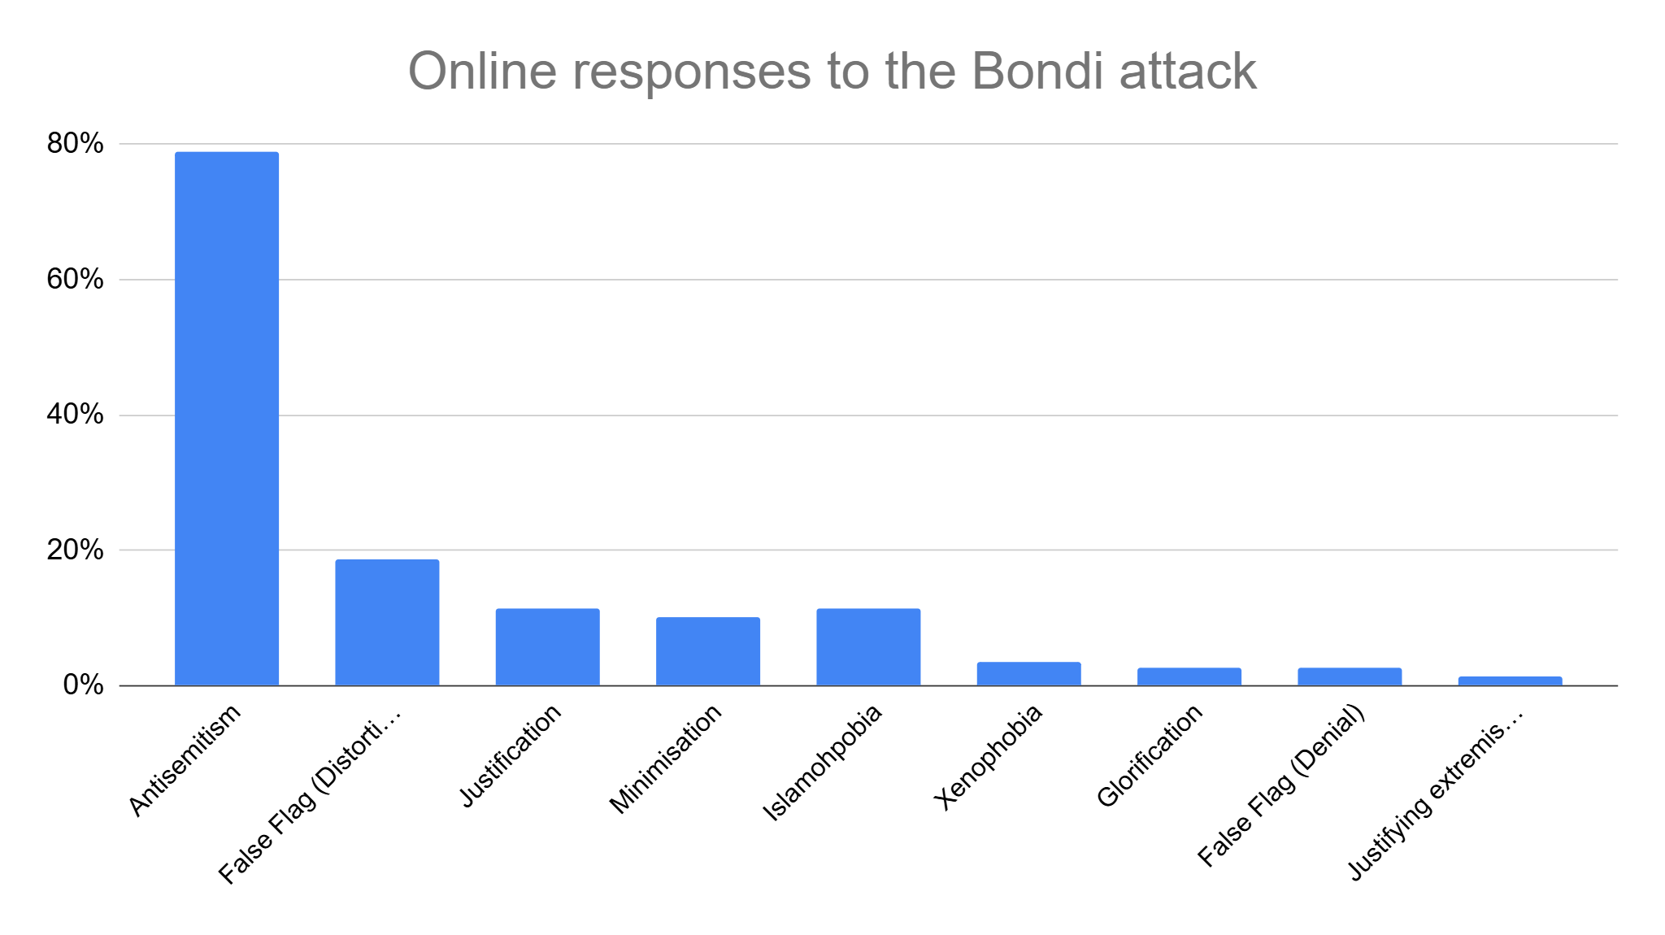
Overall breakdown
  79% of the data (515 items) involved antisemitism. This included both general antisemitism and atrocity related content.
Other types of content included Islamophobia (11%) and Xenophobia (6%).

Slide 35
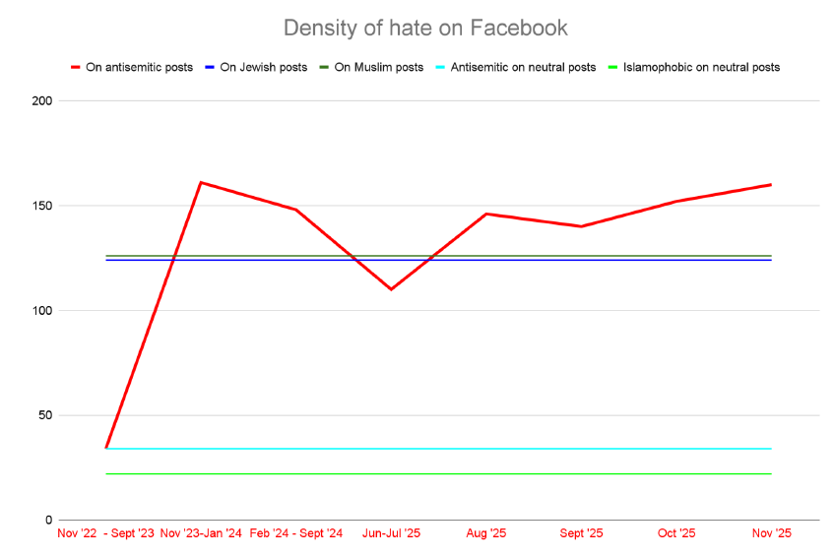
New data – January 2026
Facebook posts by some Jewish and Muslim people and organisations attracted
antisemitism / Islamophobia hate at levels similar to the level of antisemitism on Facebook when antisemitic posts are made.
On posts by media, the government, MPs, etc. we saw the same level of antisemitism as we used to see on dedicated antisemitic posts in 2022.
We also saw significant Islamophobia, but at 75% of the level of the antisemitism.

Slide 36
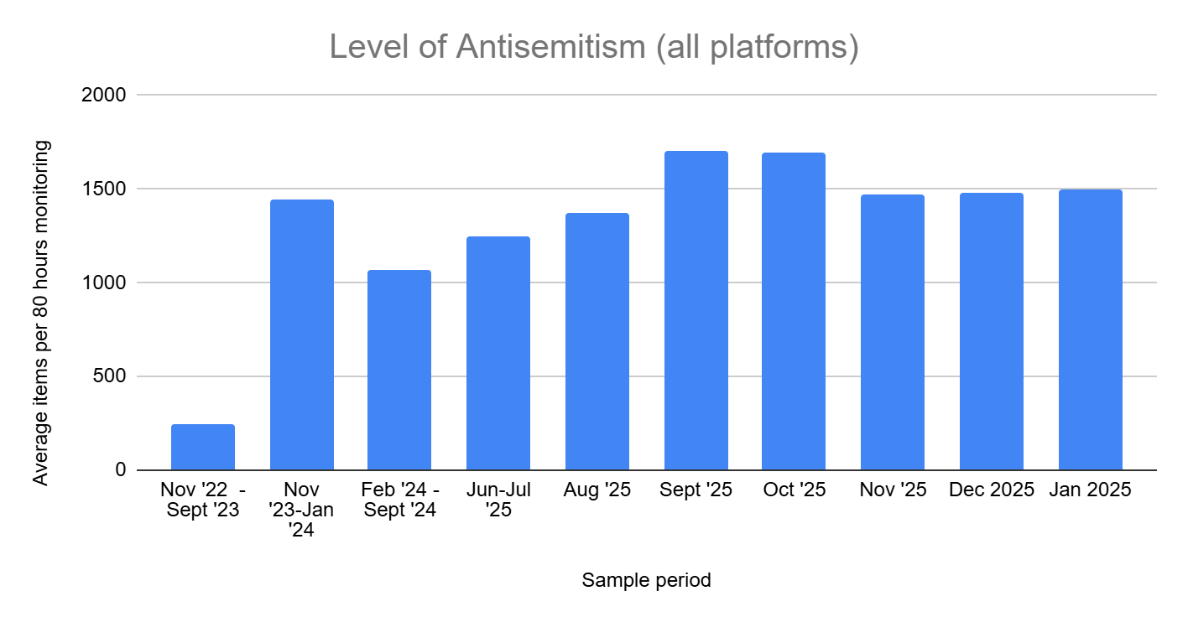

Slide 37
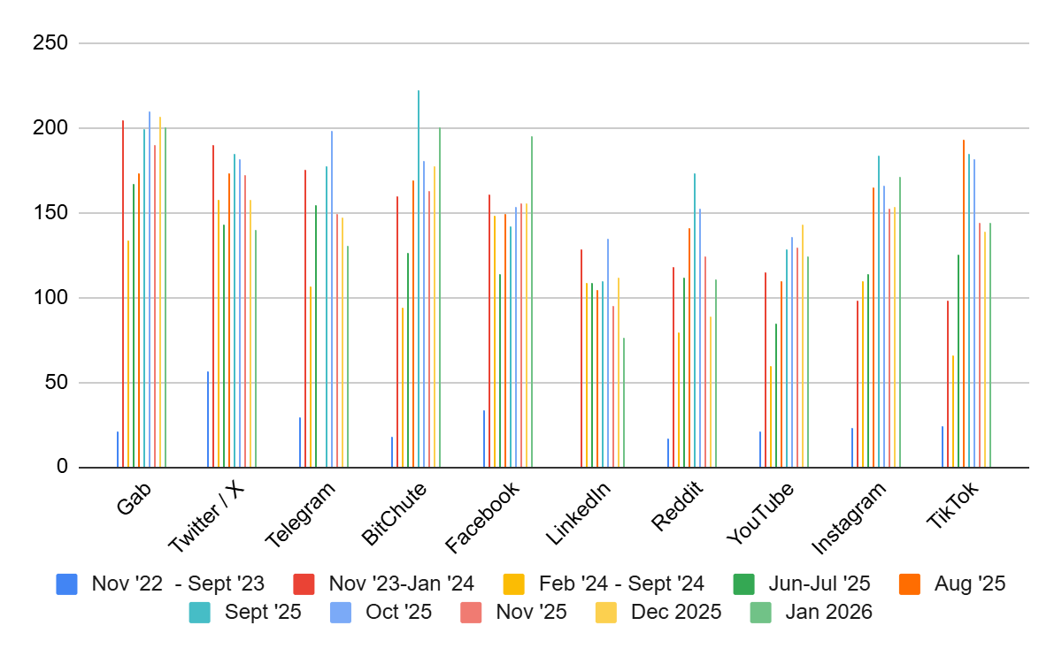

Slide 38
Platform Transparency

Slide 39
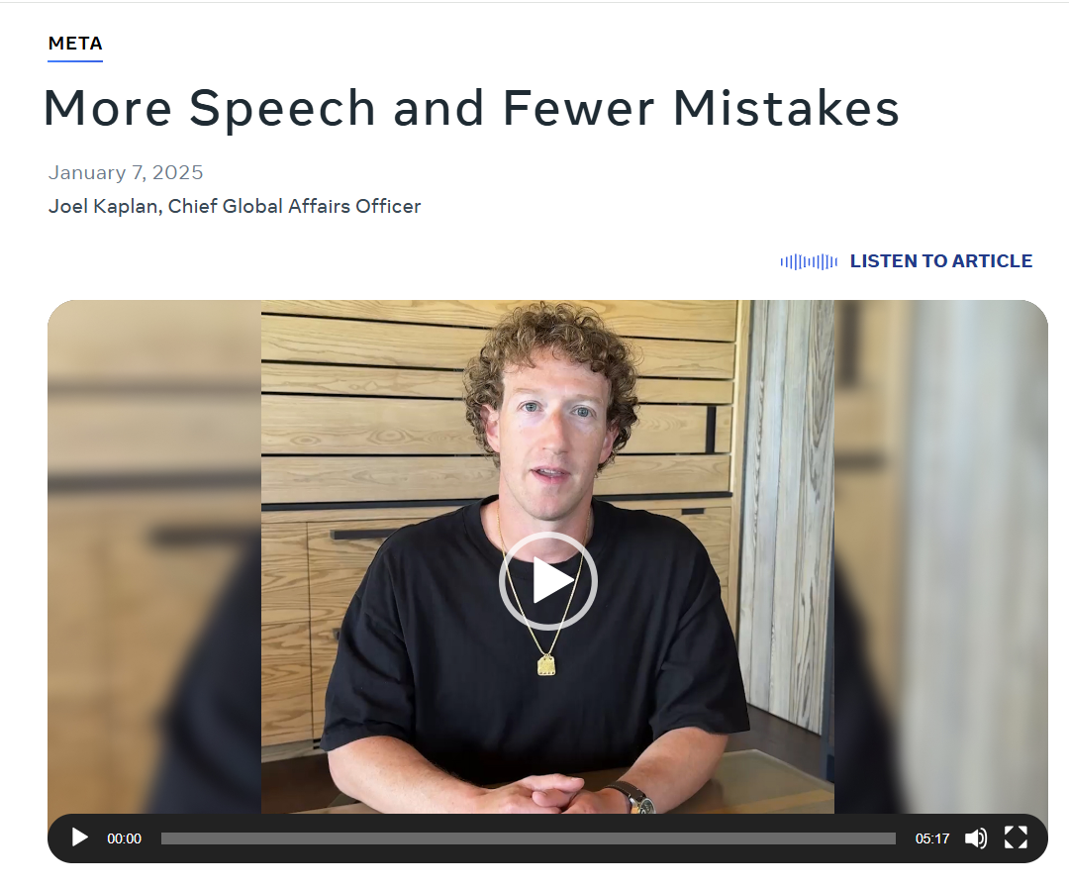
Facebook’s scales back automated removals
January 2025 Meta said, “we think one to two out of every 10 of these [removal] actions may have been mistakes”
“we have been using automated systems to scan for all policy violations, but this has resulted in too many mistakes… So, we’re going to continue to focus these systems on tackling illegal and high-severity violations, like terrorism, child sexual exploitation, drugs, fraud and scams. For less severe policy violations, we’re going to rely on someone reporting an issue before we take any action.”
https://about.fb.com/news/2025/01/meta-more-speech-fewer-mistakes/

Slide 40
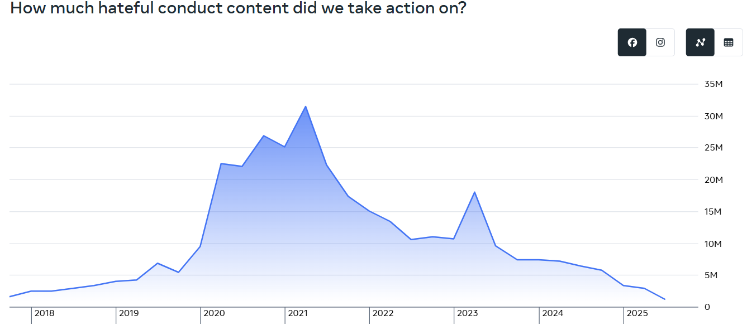
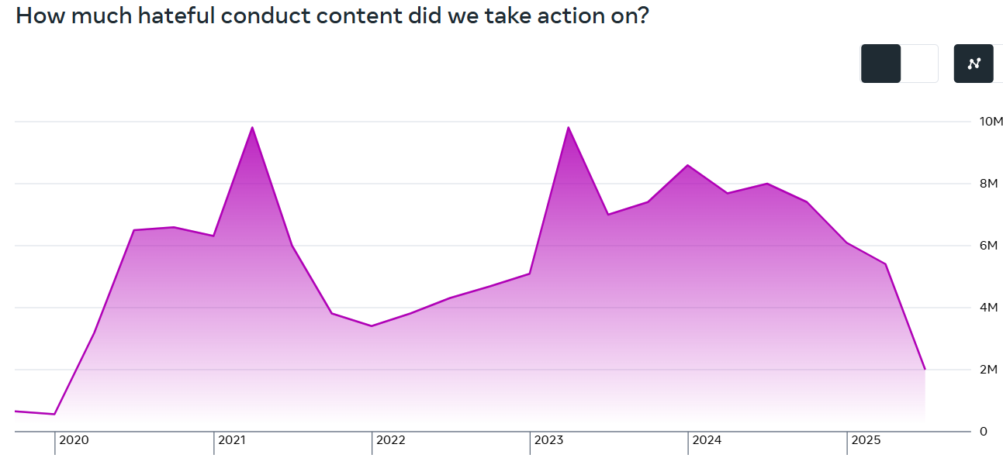
Facebook and Instagram removals
Facebook
Reduction from 5.8M (quarter before the speech) to 1.2M in the latest figures.
That’s 8 out of 10 items that were previously being removed no longer being removed.
Reduction from 7.4M (quarter before the speech) to 2M in the latest figures.
That’s 7 out of 10 items that were previously being removed no longer being removed.
Instagram
Source: https://transparency.meta.com/reports/community-standards-enforcement/hateful-conduct/facebook/

Slide 41
Questions?

Slide 42
Backup slides

Slide 43
Types of measurement
Demonstrate the problem – Example(s) of a problem
Summary data (counting problems) – Shows the problem exists at scale, a systemic problem, not as just an abortion
Coding problems – Items classified into subclasses. Empirical with qualitative judgements on categorisation and quantitative measures of frequency.
Modelling Problems – Automated identification using a search query, AI model for classification, etc.
Andre Oboler, “Trials and challenges measuring online hate” page 77 to 110
Book is open access:
https://labcom.ubi.pt/en/methods-techniques-and-ai-solutions-in-the-age-of-hostilities-online-hate-speech-trilogy-vol-iii/

Slide 44
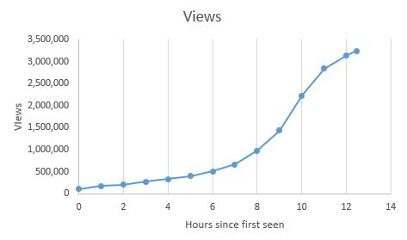
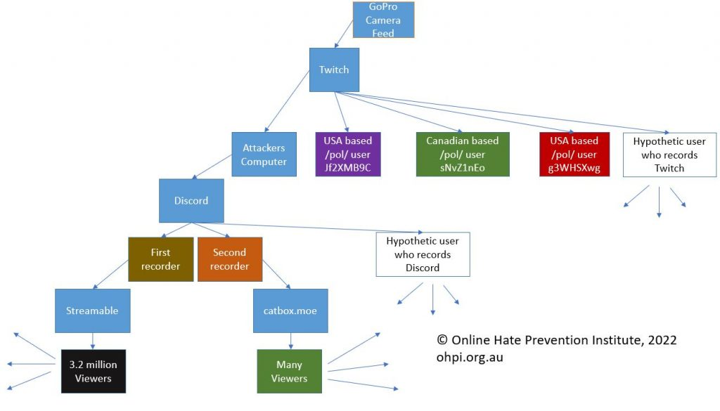
Demonstrating the problem
Response to the Buffalo Terrorist Attack
2022
Online monitoring within hours of the attack, published a work in progress immediately
Monitored the original videos distribution while seeking removal
Analysis of circumvention techniques and collaborators spreading the incitement
Exposure of links to radicalisation spaces including 4chan and the neo-Nazi site the Daily Stormer
Notes:
This shows how rapidly extremist content that can incite further violence can go viral. This all occurred within 24 hours of the attack occurring. We have no idea how many of those who viewed the video saved it and have been passing it on.

Slide 45
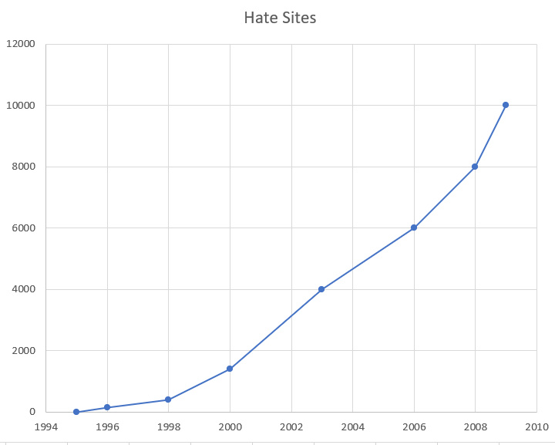
Summary data
The early rise of hate sites
Data for the graph comes from the following reports by the Simon Wiesenthal Center:
iReport Online Terror + Hate: The First Decade, 2008 https://www.csce.gov/sites/helsinkicommission.house.gov/files/Cooper%20Testimony.PDF
Facebook, Youtube+: How Social Media Outlets Impact Digital Terrorism and Hate, 2009 https://web.archive.org/web/20100331230627/www.wiesenthal.com/atf/cf/%7B54d385e6-f1b9-4e9f-8e94-890c3e6dd277%7D/LA-RELEASE_2.PDF
A Council of Europe report in October 2001 put the number of racist websites at 4,000 which suggests these numbers are very conservative.
Tallo, I. (2001). Racism and xenophobia in cyberspace. (Doc. 9263). Retrieved from https://assembly.coe.int/nw/xml/XRef/X2H-Xref-ViewHTML.asp?FileID=9540&lang=EN

Slide 46
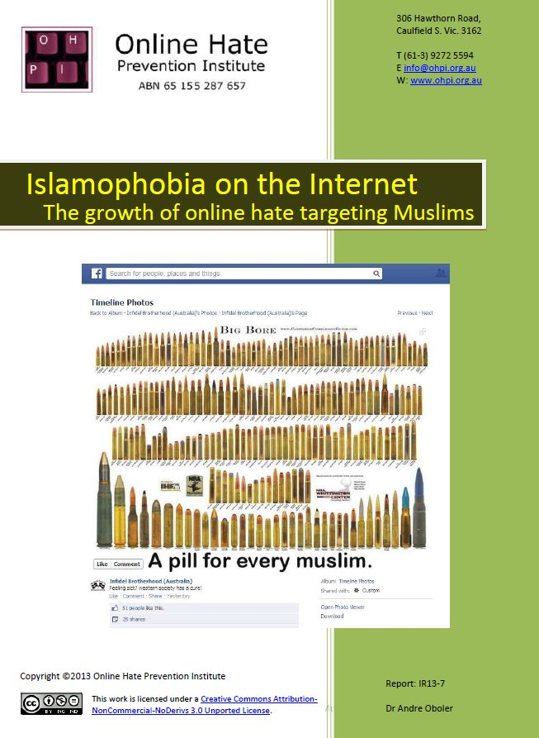
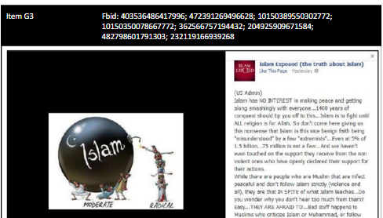
Coding Problems
World’s first report on online Islamophobia¹
2013
Examining 50 anti-Muslim Facebook pages, 349 images of hate, 191 unique memes
Category A: Muslims as a Security Threat or Threat to Public Safety (42)
Category B: Muslims as a Cultural Threat (29)
Category C: Muslims as an Economic Threat (11)
Category D: Content Dehumanising or Demonizing Muslims (37)
Category E: Threats of Violence, Genocide & Direct Hate Targeting Muslims (24)
Category F: Hate Targeting Refugees / Asylum Seekers (12)
Category G: Other Forms of Hate (36)
Each unique meme has:
A category letter and item number
A list of FBID numbers for duplicate posts
1. Oboler, A. (2013). Islamophobia on the internet: the growth of online hate targeting Muslims. Online Hate Prevention Institute. https://nla.gov.au/nla.obj-1971792213/view

Slide 47
Modelling Problems
A simple model may be a search query (a phrase, words, etc)
Complex models use Artificial Intelligence, often supervised machine learning
  AI approach to create a model using an artificial intelligence technique & known data
  Model is learned from the data so is unlikely to recognize something very new
Many current models are simply filters to create a richer target environment for manual coding approaches – at the cost of filtering out false negatives, trading partial blindness for speed.
Artificial intelligence technique
(e.g. Support Vector Machine, Artificial Neural Network, Bayesian Network etc.)
Known data
A source of “truth” to learn from and be evaluated against.
Classification model
Can now be applied to unknown data
+
→

Slide 48
Earlier efforts monitoring Antisemitism, Islamophobia and anti-Asian hate

Slide 49
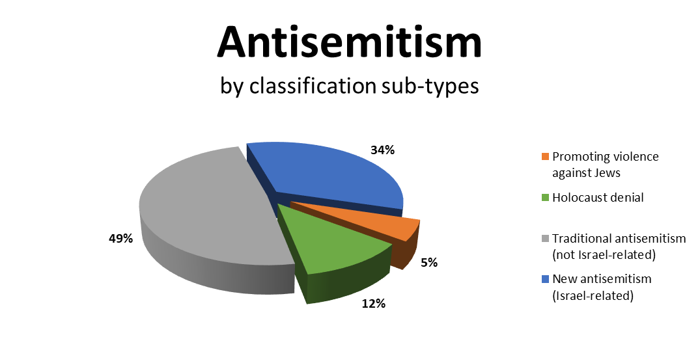
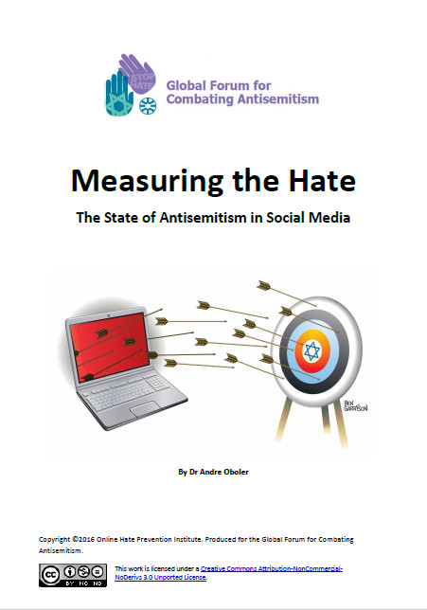
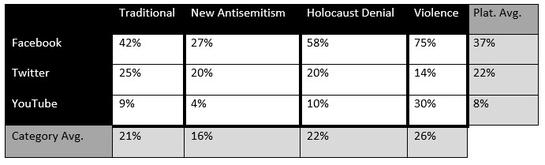
Measuring the hate (2015 pre-print, published 2016)

Slide 50






Based on a sample of 1111 Items of Anti-Muslim Hate Speech
Spotlight on Anti-Muslim Hate Report (2015)
And more.

Slide 51

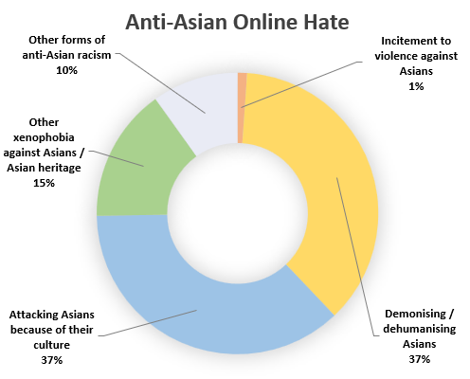







Anti-Asian Hate during Covid (2022)
Sample size: 182 items on Facebook & Instagram
Partners:
Stakeholders included:

Slide 52
Atrocity related antisemitism after the Bondi massacre

Slide 53
Antisemitism – Atrocity Distortion
75 items of atrocity distortion, blaming someone other than the attackers

Slide 54
Antisemitism – Atrocity justification
75 items of atrocity justification, rationalising the attack

Slide 55
Antisemitism – Atrocity Minimization
66 cases of atrocity minimization, down-playing the attack

