Slide 1

A Brief Overview of
Technology Impact Assessment https://rogerclarke.com/EC/TIAN.html https://rogerclarke.com/EC/TIAN.pdf
Roger Clarke
Xamax Consultancy Pty Ltd, Canberra
Visiting Professor, A.N.U. and U.N.S.W
Australia India Joint Impact Assessment of
Critical Technologies for Peace and Stability
ANU – 7 February 2025

Slide 2
Assessment Categories by Focus
Compliance Focus
Regulatory Compliance
  Org'l Self-Regulation
  Industry Self-Regulation
  Co-Regulation
  Formal Regulation
Privacy Law Compliance
  All Statutes, Delegated Legislation, Common Law
Data Protection Law Compliance
  An EU Directive, a Statute
Project or Proposal
Achievability of Objectives
subject to Constraints
Social Impact
Impacts of an Activity on
Social Asset(s) / Value(s)
Technology
Impacts of an Activity on
Any / All Asset(s) / Value(s)

Slide 3
Assessment Techniques
Project or Proposal Focus
Business Case Formation
Security Impact, aka
Threat Risk Assessment (TRA)
Social Impact Focus
Data Privacy IA
Privacy Impact Assessment
Surveillance IA
Human Rights IA
Ethical IA
Technology Focus
Technology Assessment

Slide 4
Technology Assessment
"A scientific, interactive and communicative process, which aims to contribute to
the formation of public and political opinion
on societal aspects of science and technology"
European Parliamentary Technology Assessment (EPTA) network
http://www.eptanetwork.org/
The Key Scoping Factors:
The Technologies Considered
The Environment Impacted
The Perspectives Reflected
The Values Impinged Upon

Slide 5
Stakeholder Theory
Created as a counterpoint to ‘Shareholders'
Applied across many management contexts, incl.:
Users of information systems
‘Usees’ of information systems
Those impacted by it even though not participants in it
Attributes of Power, Legitimacy, Urgency, Proximity
Sponsoring organisations tend to consider only the Stakeholders capable of affecting project success
Legitimate-but-not-Powerful Stakeholders are
not even seen as constraints let alone objectives
Freeman & Reed 1983, Mitchell et al. 1997,
Driscoll & Starik 2004, Laplume et al. 2008

Slide 6
Abstraction Levels of ‘Stakeholder’
Individual Entity
Group
Category / Segment
Community
Society
Economy
Polity
Environment / Biosphere / Nature
Jacobs M. (2003) 'The Environment as Stakeholder' Business Strategy Review 8,2 (February 2003) 25-28

Slide 7
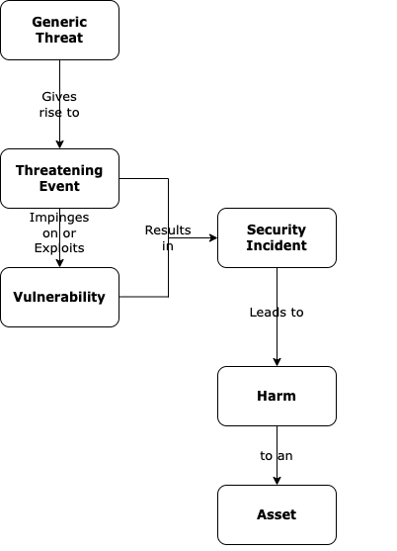
The
Conventional
Security
Model
Clarke R. (2015)
'The Prospects of Easier Security for SMEs and Consumers’
Computer Law & Security Review 31,4 (August 2015) 538-552

Slide 8
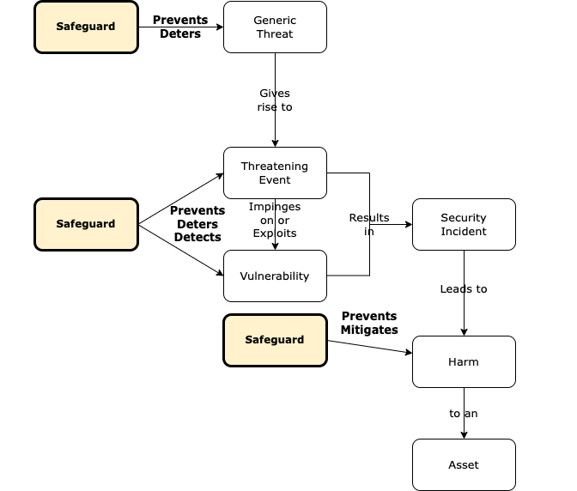
The
Conventional
Security
Model
+
Safeguards

Slide 9
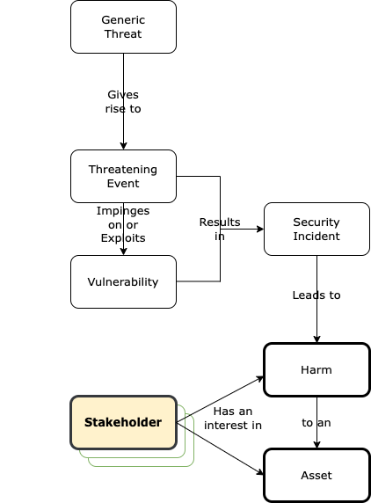
The
Conventional
Security
Model
+
Stakeholder

Slide 10
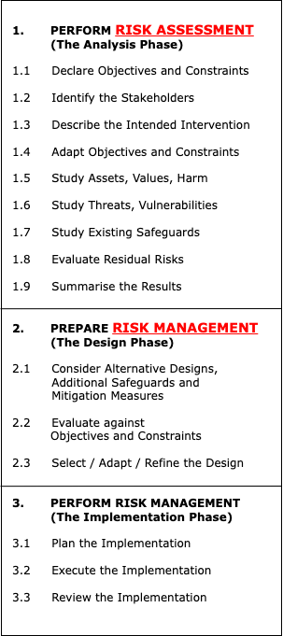
Risk
Assessment
&
Risk
Management
Enterprise-Level

Slide 11
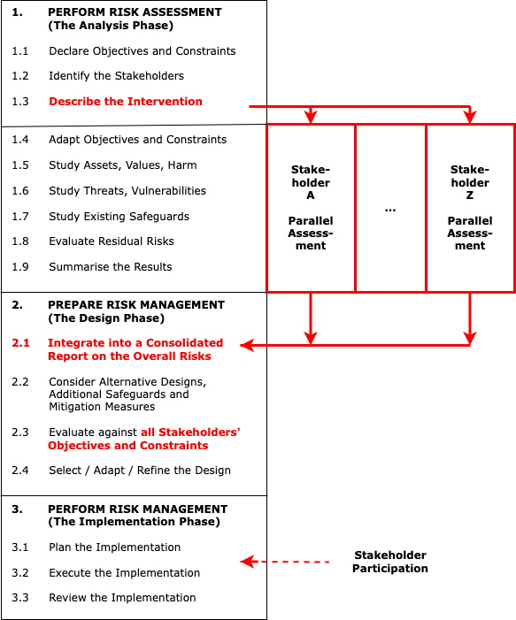
Multi-
Stakeholder
Risk
Assessment
&
Risk
Management
‘Multi-Stakeholder Risk Assessment of Socio-Technical Systems Projects’
https://rogerclarke.com/DV/MSRA-ACIS24-241011.pdf

Slide 12
Researcher Perspective Theory
A Researcher Perspective is a particular stakeholder perspective that is adopted by a researcher as the, or a, viewpoint from which
to observe phenomena during the conduct of a research project
90% of Info Systems Research is Single-Perspective
  In 90% of that 90%, the System Sponsor is in focus
  Users and Usees are seldom the focal point
Dual-Perspective Research can reflect both System-Sponsor
and User views, and inter-relate them, to the benefit of both
Multi-Perspective Research is challenging, and uncommon
Clarke R. & Davison R.M. (2020) 'Through Whose Eyes?
The Critical Concept of Researcher Perspective’
J. Assoc. Infor. Syst. 21,2 (March-April 2020) 483-501
PrePrint at http://rogerclarke.com/SOS/RP.html

Slide 13
Some Challenges in
Technology Impact Assessment
Stakeholder Richness and Levels of Abstraction
Level of Abstraction of the Technology
Anticipated, Recognised, Unforeseen Trajectories
Domains of Use
Enablement/Facilitation/Support & Regulation
Nurturing Innovation / Progressive Protections
Cultural Diversity

Slide 14
Addressing the Challenges
Level of Abstraction of the Technology
Careful Definition of the Scope of the technology
Sufficiently deep Understanding of it
Segmentation by Technology, App Domain, etc.
Generic Policy based on principles
Policy Articulation into operational controls through co-regulatory arrangements

Slide 15
Addressing the Challenges
Hofstede/Minkov Dimensions of Culture
Power distance index
Individualism vs. collectivism
Uncertainty avoidance
Motivation towards Achievement and Success (cf. Masculinity and Femininity)
Long-term vs. short-term orientation
Indulgence vs. restraint
https://geerthofstede.com/culture-geert-hofstede-gert-jan-hofstede/6d-model-of-national-culture/
Minkov M. (2012) 'Cross-Cultural Analysis: The Science and Art of Comparing the World's Modern Societies and Their Cultures' Sage, 2012

Slide 16
Information Deliverables during a TIA Process
Potential Positive Impacts, Likely Impediments
Potential Negative Impacts, Implications, Risks
Potential Safeguards and Mitigation Measures
Outcomes Equity,
Harm Avoidance, Mitigation
Policy Options
Audience Definition
The Technology/ies
Past and possible future Trajectories
Known and possible Features
Likely, possible Applications
Stakeholders, Proxies for them
Relevant Values that may
be impinged upon
Relevant Social-Political Criteria

Slide 17
Alternative TIA Modus Operandi
Authoritative – with outreach or consultation.
Performed by a team with competencies in TA methods. Input from relevant parties welcomed at some stages.
Coordinative / Collaborative – with participation.
The team is open-ended, or open at all stages to input from any interested party, particularly during the formative phases and again once a draft is in place.
Competitive/Dialectic – with debate or dialogue.
Thesis / antithesis / synthesis.
Seeks emergence of consensus or compromise.
Fallback is publication of evidence, reasoned argument re two or more alternative analyses and policy proposals.

Slide 18
Research Methods for Futures Studies
Quasi-Empirical Research
Grounded
Delphi Studies
Vignettes /
Mini-Case-Studies
Game-based /
Role-Playing Studies
Simulation Modelling
Scenario Analysis
Conceptual Research
Conventional
Delphi Studies
Visionary Depiction
  Utopian
  Dystopian
  Balanced
Critical Theory Research

Slide 19
A Brief Overview of
Technology Impact Assessment https://rogerclarke.com/EC/TIAN.html https://rogerclarke.com/EC/TIAN.pdf
Roger Clarke
Xamax Consultancy Pty Ltd, Canberra
Visiting Professor, A.N.U. and U.N.S.W
Australia India Joint Impact Assessment of
Critical Technologies for Peace and Stability
ANU – 7 February 2025

Slide 21
OPTIONAL DRILL-DOWN SLIDES

Slide 22
Social Impact Assessment
Rights IA UDHR, ICCPR, ICESCR
Ethical IA Ethical Issues, Participative Design
Surveillance IA Many Values & Ind'ls/Groups/Society
Privacy IA All Dimensions of Privacy
Data Privacy IA Only the Data Privacy Dimension
The Dimensions of Privacy
The Physical Person
Personal Data
Personal Communications
Personal Behaviour
Personal Experience
http://www.rogerclarke.com/DV/Intro.html#Priv

Slide 23
A Rich Assortment of Definitions
No consensual, unambiguous and selective definition of TA has yet been provided ... the most common collective designation of the systematic methods used to scientifically investigate the conditions for and the consequences of technology and technicising ... (Grunwald 2009)
A form of policy research that examines short- and long-term consequences (for example, societal, economic, ethical, legal) of the application of technology ... to provide policy makers with information on policy alternatives (Banta 2009)
A scientific, interactive and communicative process, which aims to contribute to the formation of public and political opinion on societal aspects of science and technology (EPTA 2017)
Health Technology Assessment (HTA) is a multidisciplinary process that uses explicit methods to determine the value of a health technology at different points in its lifecycle. The purpose is to inform decision-making [re health systems] (O'Rourke et al. 2020)

Slide 24
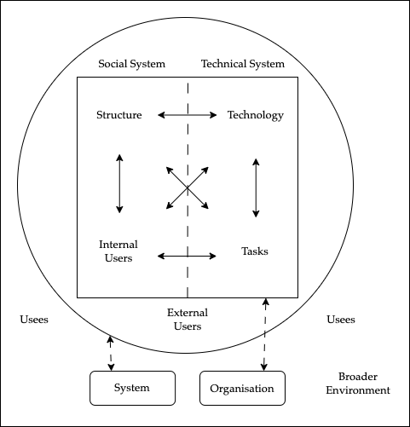
An Open Socio-Technical System
Enhancement to Bostrom & Heinen (1977)
Clarke, Michael & Abbas (2024) 'Robodebt: A Socio-Technical Case Study of Public Sector Information Systems Failure’, at https://ajis.aaisnet.org/index.php/ajis/article/view/4681/1481

Slide 25
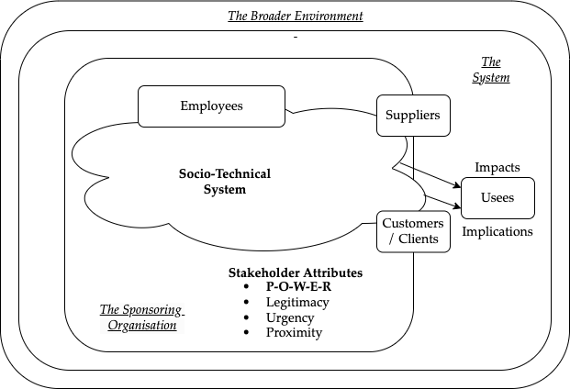
Stakeholders in a Social-Technical System
Driscoll C. & Starik M. (2004) 'The primordial stakeholder: Advancing the conceptual consideration of stakeholder status for the natural environment' Journal of Business Ethics 49 (2004) 55-73

Slide 26
The Two-Step Approach to Achieving a
Meaningful Discussion about Security
1. Establish a Security definition, e.g.
A condition in which an Entity
does not suffer Harm from Threatening Events
2. Establish a Scope Definition:
Security
Of What?
Against What?
For Whose Benefit?

Slide 27
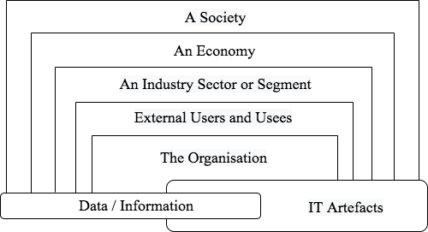
Alternative Scope Definitions
for Security Analysis
http://rogerclarke.com/EC/WS-1301.html

Slide 28
Attacks
By Whom? Why?
Principals
Opportunists
Hacktivists
Vigilantes
Organised Crime
Corporations
Nation-States
Agents
Mercenaries
Private Military
Corporations
Politics
• Protest against Action
• Retaliation / Revenge
• Espionage
Economics
• Financial Gain
• Financial Harm
Social/Cultural Factors
• Challenge
• Dispute
• Celebration

